Slide 1

Trends
Information Systems and Management

Slide 2
Trends
Disruptive versus Sustaining
Wireless
IT Focus for organizations
IRM
  Strategic vs.
  Operational
CIO
Effective
CTO
Efficient

Slide 3
Fostering an Innovative Organization
Disruptive Technology
  Facilitates a new way of doing things
Sustaining technology
  Facilitate doing current things better
What about…?
  Internet
  ERP

Slide 4

Creating a Wireless Organization
Wireless Technologies
  Transforming how we live, work and play
    Cell phones
    GPS
    Cordless peripherals
    Satellite TV
  WiMax
  RFID
  Micro Hard Drives

Slide 5
Developing a 21st Century Organization
Primary IT focus for organizations
  IT infrastructure
    Provide a foundation to support the organization’s goals
  Security
    Opening networks and applications to customers, partners, and suppliers using a diverse set of computing devices and networks
  E-business
    Mobility and wireless
  Integration
    Align business and technology

Slide 6

Information Resource Management
Recognition that data and information are a valuable resource just like people, money and machines.

Slide 7

Strategic Management
Manage IT so that it makes a major contribution to the profitability and strategic objectives of the firm.
CIO
  Oversee all IT
  Align IT with strategic goals
Strategic IS Planning
  Business driven, not technology driven
  Align with strategic goals

Slide 8
Operational Management
Centralization vs. Decentralization
Management Techniques
Managing Systems Development
Managing IS Operations

Slide 9
Operational Management
Centralization versus Decentralization
  IT can be used to encourage either
    SWP Grain Division: Centralized
    SWP Farm Service Division: Decentralized
Management Techniques
  Information Centres versus Help Desk
    Support end users
  Outsourcing
    Facilities management
    System integrators

Slide 10
Operational Management
Managing Systems Development
  Use a standard System Development Life Cycle
Managing IS Operations
  Performance monitors: throughput, capacity planning, quality control
  Chargeback systems

Slide 11
The Need for Information Filtering
We need to deal with so much information
Push, not pull technologies
  Push Technology: organizations provide information, services, and product offerings based on potential customer’s profile

Slide 12

Intellectual Computing
Artificial Intelligence
Expert Systems
Automatic Speech understanding
  With truly intelligent software, speech recognition will become speech understanding
    Troy Westwood

Slide 13
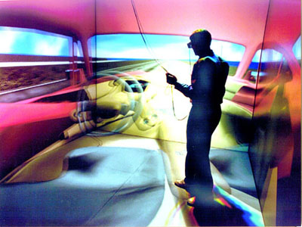
Physiological Interaction
Biometrics: the use of physical characteristics to provide identification
Virtual Reality
  Computer simulation
  Glove
  Headset
  Walker

Slide 14
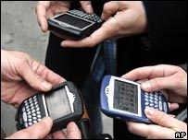

Portability and Mobility
Portability: how easy it is to carry around technology
Mobility: encompasses what
you can do with the
technology while carrying
it around
Wearable computers
Implant Chips

Slide 15
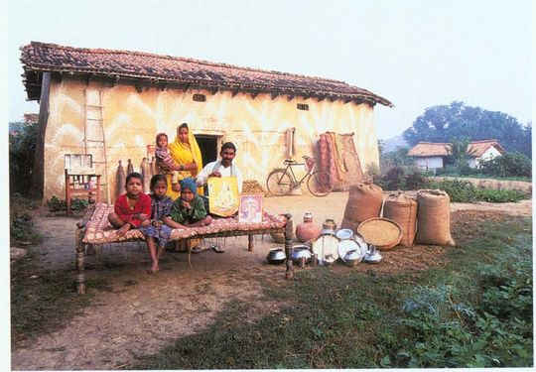
Digital Divide
Developing Nations
Only if they want or need it
  Watch Story

Slide 16

Global IT Management
The International Dimension
  In your career you will be affected by international business development and deal, in some way, with people, products or services whose origin is not from your home country.

Slide 17
Global IT Management
Challenges
Cultural
  Customs, attitudes, working styles, business relationships
Political
  Data transfer, content laws, revenue spending
Geo-Economic
  Distances, time zones, infrastructure

Slide 18

Global IT Management
Local Content Laws
  Specify that a portion of all the value of the product must be added in that country if it is to be sold there.
Reciprocal trade agreements
  Requires businesses to spend part of revenue in the country
  NAFTA

Slide 19

Global Data Issues
Trans-border Data Flows (TDF)
  Government intervention
    Violating National Security
    Avoiding Customs Duties
    Violation of Privacy Legislation
Global Systems Development (Outsourcing)
  It takes longer to reach an understanding and agreement on system requirements and deliverables when users and developers are in different countries

Slide 20
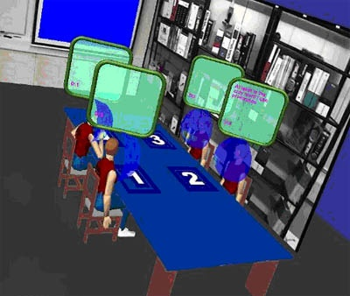
Collaboration Systems
IT based set of tools that supports the work of teams by facilitating the sharing and flow of information.
Content Management Systems
Workflow Management Systems
Groupware Systems
Virtual Teams
Knowledge Management Systems

Slide 21
Tools and Systems
Electronic Communication Tools
  E-mail, VOIP, Web publishing
Electronic Conferencing Tools
  Data and voice conferencing
  Video conferencing
Chat systems
Electronic Meeting Systems
  Group Decision Support Systems
  Special purpose rooms

Slide 22
Outsourcing
Insourcing
  Using professional expertise within an organization
Outsourcing
  One organization provides services to another organization
Offshore Outsourcing
  Using organizations from developing countries to write code and develop systems

Slide 23
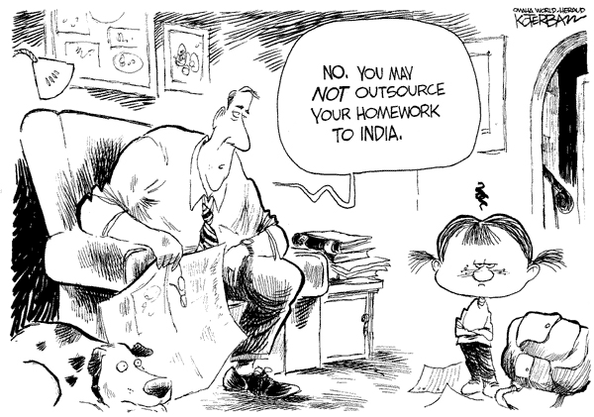

Slide 24

Challenges of Outsourcing
Contract Length
Competitive Edge
Confidentiality
Scope

Slide 25
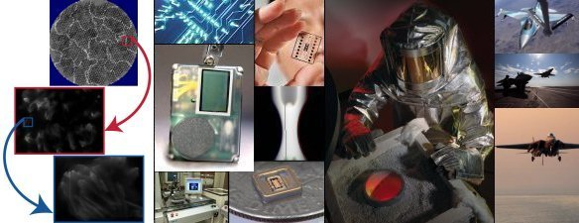
Outsourcing Future Trends
Many outsourcing companies are being established
  Increasing competition
  Reducing profit margins
  Increasing buyer`s choices
Multi-Sourcing
  A general contractor who organizes sub-contractors
  Integrate a collection of IT services based on customer`s needs

Slide 26
Trends
Information Systems and Management

